Slide 2





Hierarchical inheritance:
One base class and multiple derived class, one –to-many relationship

Slide 3
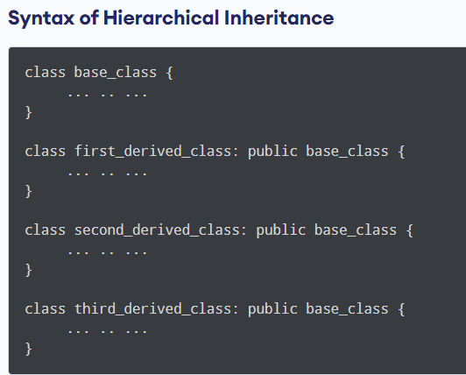

Slide 4
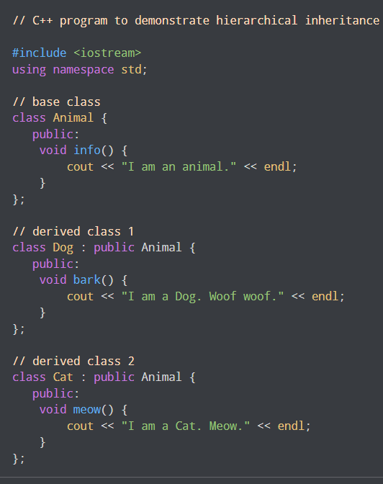
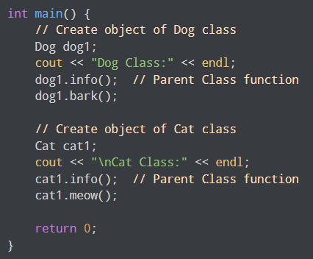
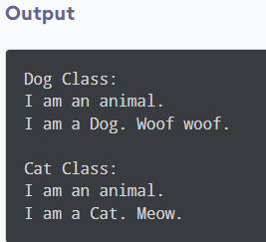

Slide 5
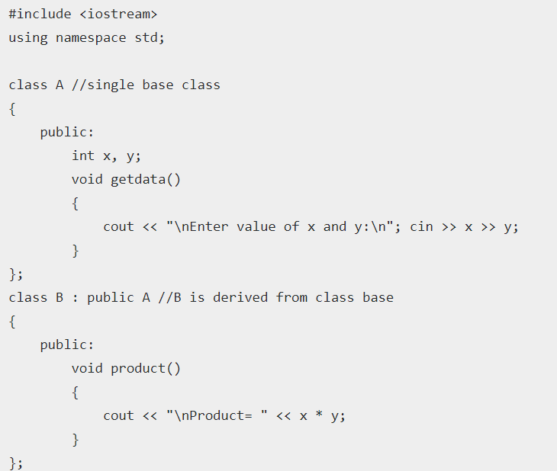
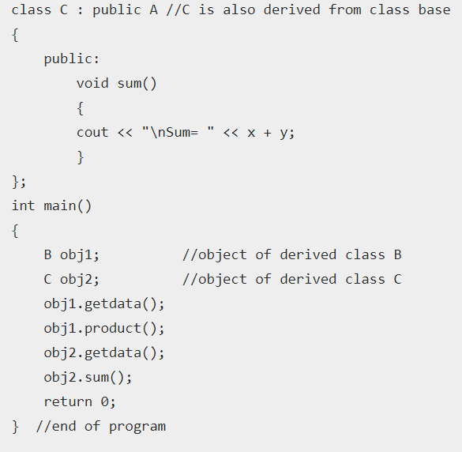
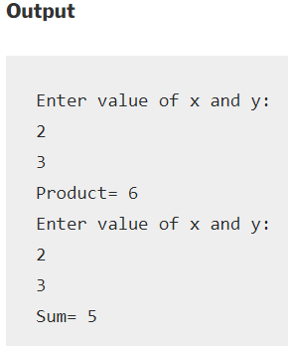

Slide 6
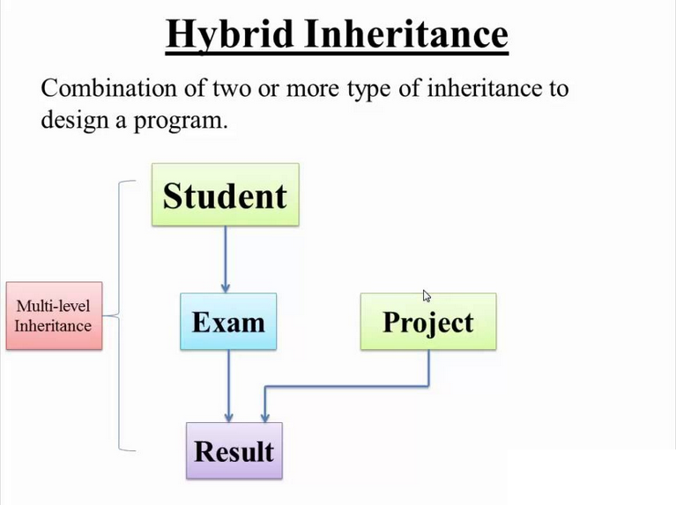

Slide 7
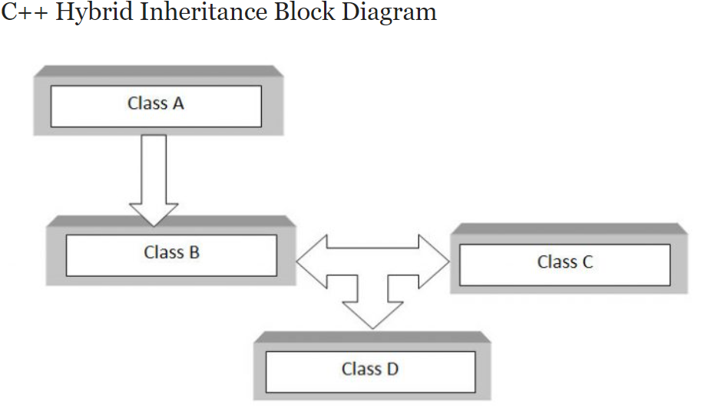
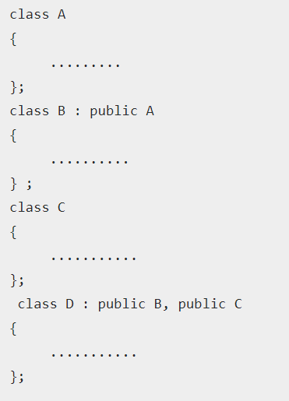

Slide 8
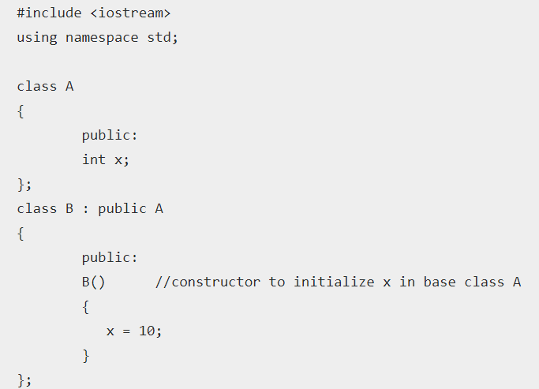
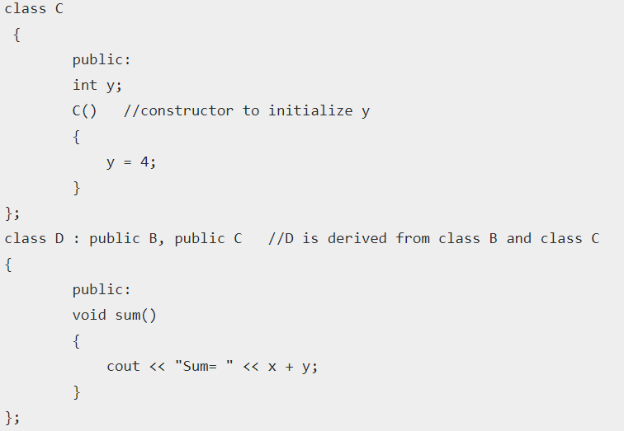
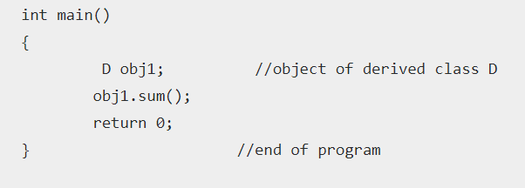

Slide 9


Type Conversion

Slide 10
A type cast is basically a conversion from one type to another. There are two types of type conversion:
Implicit Type Conversion Also known as ‘automatic type conversion’.
Done by the compiler on its own, without any external trigger from the user.
Generally takes place when in an expression more than one data type is present. In such condition type conversion (type promotion) takes place to avoid lose of data.
All the data types of the variables are upgraded to the data type of the variable with largest data type.
bool -> char -> short int -> int -> unsigned int -> long -> unsigned -> long long -> float -> double -> long double

Slide 11
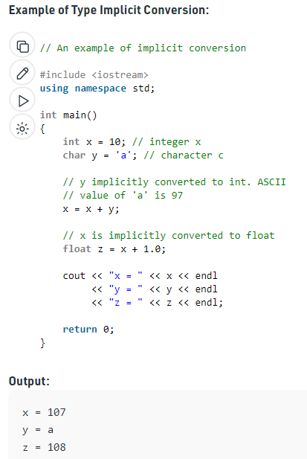

Slide 12
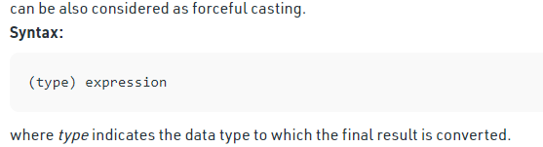
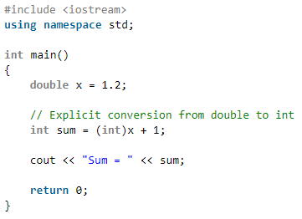

Explicit Type Conversion:
This process is also called type casting and it is user-defined. Here the user can typecast the result to make it of a particular data type.

Slide 13
Type Conversion in user-defined data
User define data type conversion not done automatically
A user-defined data types are designed by the user to suit their requirements, the compiler does not support automatic type conversions for such data types therefore, the user needs to design the conversion routines by themselves if required.
User define data type conversion done by using either constructor or by using casting operator

Slide 14
Three type of situation occurs during user define type conversion:
1. basic type to class type(using constructor)
2. class type to basic type(using casting operator function)
3. class type to class type (using constructor and casting operator function both)

Slide 15
1. basic type to class type-using constructor To perform this conversion, the idea is to use the constructor to perform type conversion during the object creation.
Basic type to class type achieved by using constructor.
#include <iostream>
using namespace std;
class A
{
};
int main()
{
A a1;
int x=8;
a1=x ;//basic to class type
return 0;
}

Slide 16
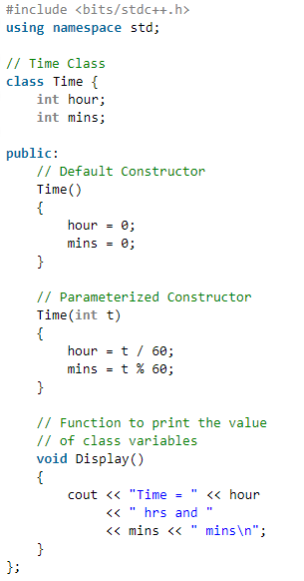
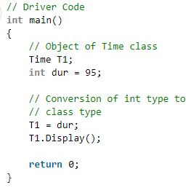

convert int to user-defined data type:

Slide 17
2. class type to basic type-using casting operator function
Class type to basic type done by using casting operator function
It must be a define inside in class.
It must not specify a return type in function signature.
It must not have any arguments.
class A
{};
A a1;
int x;
x=a1 //class type to basic type

Slide 18
casting operator function
Syntax:
operator dest_typename()
{
return statement;
}
operator int()
{
return a;
}

Slide 19
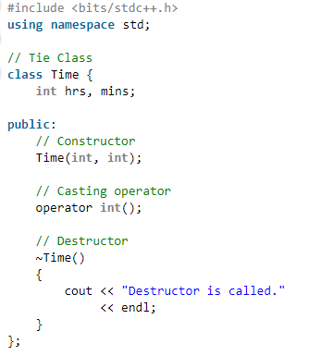
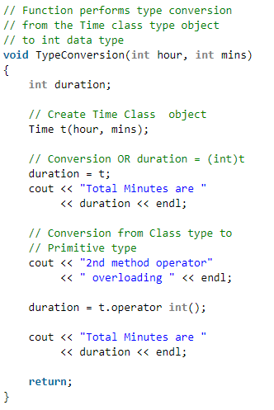
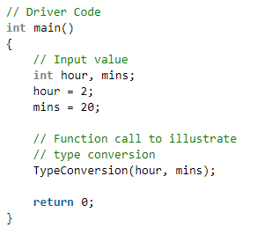
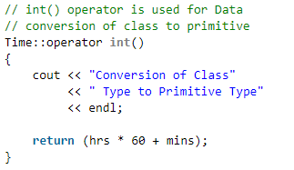
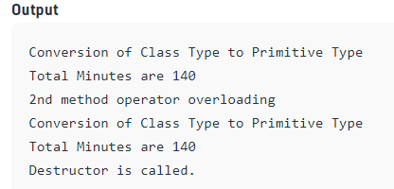

Slide 20
Conversion of one class type to another class type
Ex: A obj1; B obj2;
obj1 = obj2 ; // obj1 and obj2 are objects of different classes
First approach using Constructor:-
Left side of assignment operator(=) which is class object we have to create constructor in that class here in Class A.
Second approach using casting operator function:
Right side of assignment operator(=) which is class object we have to create casting operator function in that class here class B.

Slide 21
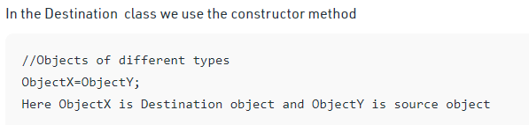
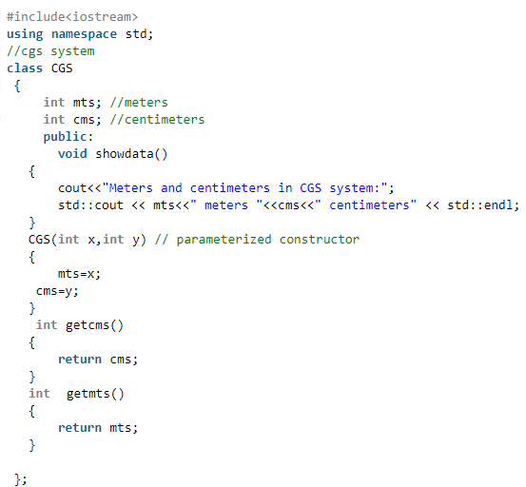
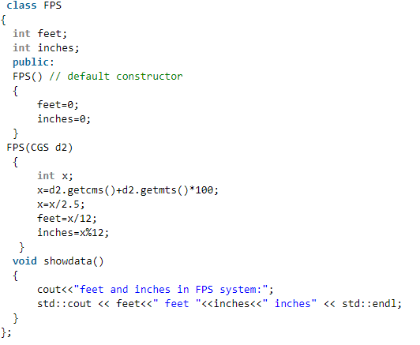
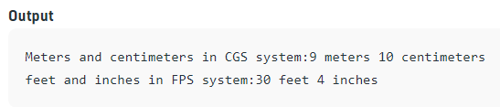
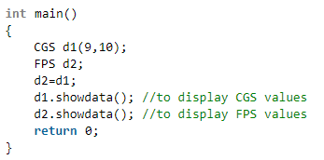
1.Using constructor :

Slide 22
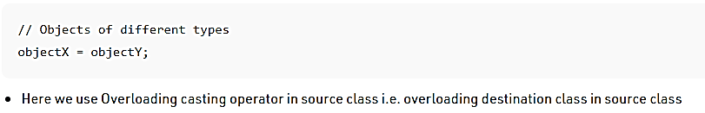
2.Using Overloading casting operator
we have two classes Time and Minute respectively and will convert one class Time to another Minute class.
In the below example minute class is destination class and time class is source class
so we need to overload the destination class in the source class
Here we should not tell the return type but we returns the overloaded class object
i.e. returning value without specifying return type

Slide 23
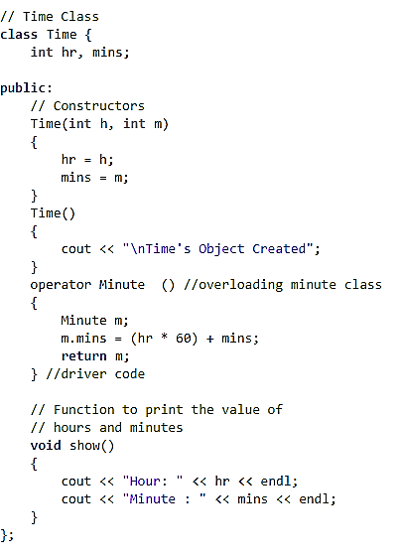
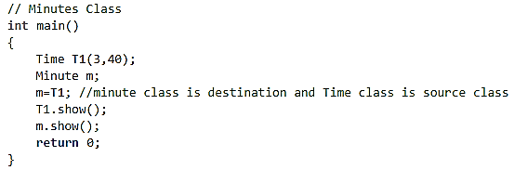
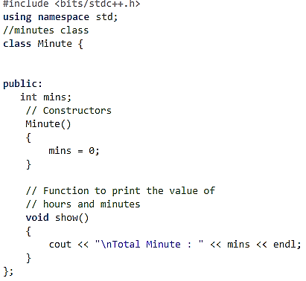
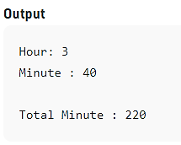

Slide 24
Any Query?

